Slide 2
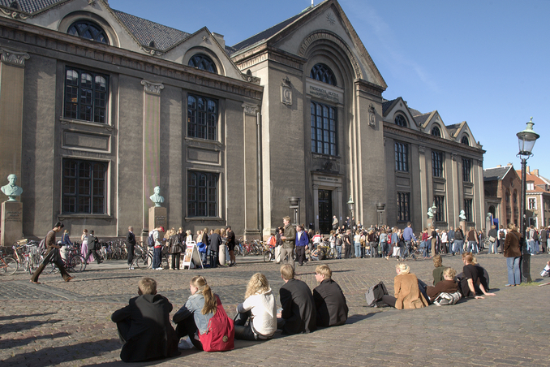
University of Copenhagen – inaugurated on 1st June 1479

Slide 3
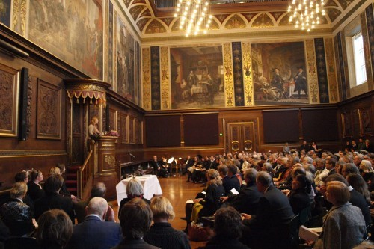

Slide 4
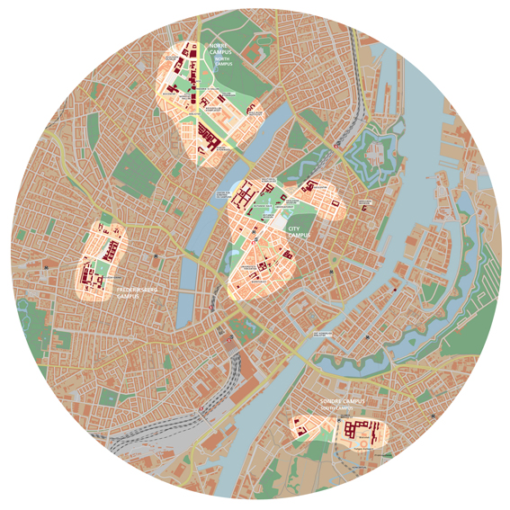
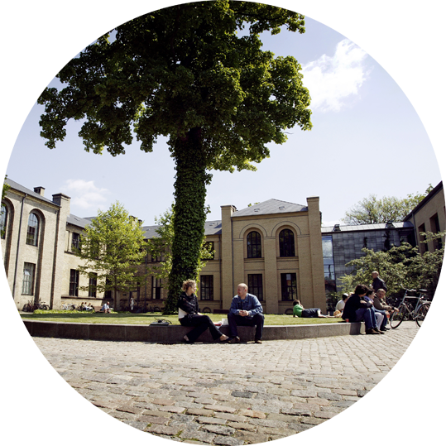
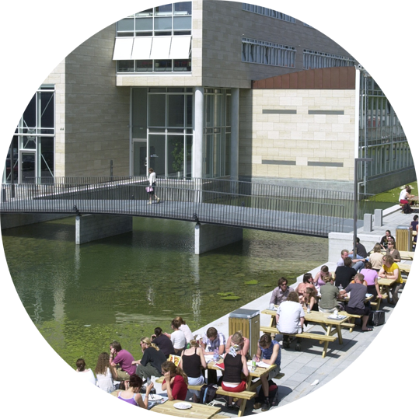
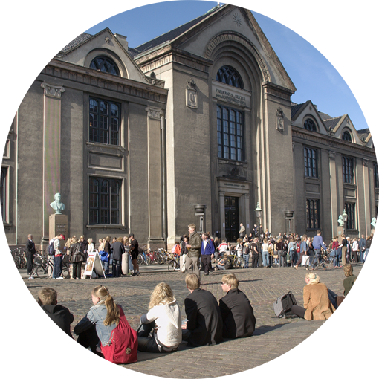
Four campuses in central Copenhagen
City Campus
North Campus
Faculty of Health and Medical Sciences
Faculty of Law
Faculty of Science
Faculty of Social Sciences
Faculty of Theology
Central Administration
Faculty of Science
Faculty of Health and Medical Sciences
BRIC
Frederiksberg Campus
South Campus
Faculty of Health and Medical Sciences
Faculty of Science
Faculty of Humanities
Notes:
Geografisk fordeler universitetets bygninger sig på fire campusområder:
City Campus:
Huser Det Teologiske Fakultet, Det Juridiske Fakultet, Det Samfundsvidenskabelige Fakultet, Dele af Det Naturvidenskabelige Fakultet samt universitetets fællesadministration.
Frederiksberg Campus:
Huser Det Biovidenskabelige Fakultet.
Nørre Campus:
Huser Det Sundhedsvidenskabelige Fakultet, Dele af Det Naturvidenskabelige Fakultet samt Det Farmaceutiske Fakultet.
Søndre Campus:
Huser Det Humanistiske Fakultet.

Slide 5
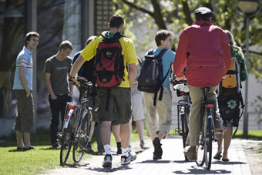
University of Copenhagen
38,000 students
9,000 employees, including 5,000 scientists
8 Nobel prizes
€ 1 billion turnover
Ranked: no. 1 in the Nordic countries, no. 3 in Europe and no. 39 in the world (Academic Ranking of World Universities Shanghai, 2014)

Slide 6
